Slide 1


VOCAL PATH
A CLOUD-ENABLED INTELLIGENT SYSTEM FOR ADAPTIVE SPEECH THERAPY IN STUTTERING
Presented by :
25-26J-383

Slide 2

PROBLEM STATEMENT & STAKEHOLDERS
CONTEXT:
Limited access to Speech-Language Pathologists in Sri Lanka makes early treatment for children (ages 5–10) with stuttering difficult.
STAKEHOLDERS:
Primary Users: Children who stutter (CWS).
Secondary Users: Parents and Speech-Language Therapists/Clinicians.
OBSERVED ISSUE:
Current stuttering diagnosis is subjective, slow, and not suited for Sinhala-speaking children, especially in rural areas.
WHY IT MATTERS:
Untreated stuttering can cause anxiety, social withdrawal, and lower classroom engagement.

Slide 3
RESEARCH GAP & OBJECTIVES
RESEARCH GAP
MAIN OBJECTIVE
Current systems are mostly English-only, manual, or need cameras making home use difficult.
Build a cloud-based, AI-powered platform delivering personalized, audio-only speech therapy for children.
SPECIFIC OBJECTIVES
Supports Sinhala & English for children.
Detects stuttering/disfluencies.
Monitors improvement over time.
Gives pronunciation tips and exercise suggestions.

Slide 4

SOLUTION OVERVIEW
Key Features Delivered
ML Classifier – Detects repetitions, prolongations, and blocks using acoustic features (MFCCs, pitch).
Adaptive Recommender – Personalizes exercise difficulty with KNN based on performance history.
Pronunciation Feedback – Uses ASR (Whisper/Google STT) for phoneme-level correction.
Non-functional Focus
Child-friendly gamified usability, high accessibility (large fonts/contrast), and compliant data security .
Solution Summary:
A mobile ecosystem (Vocal Path) that automates stuttering detection and delivers dynamic therapy exercises .

Slide 5
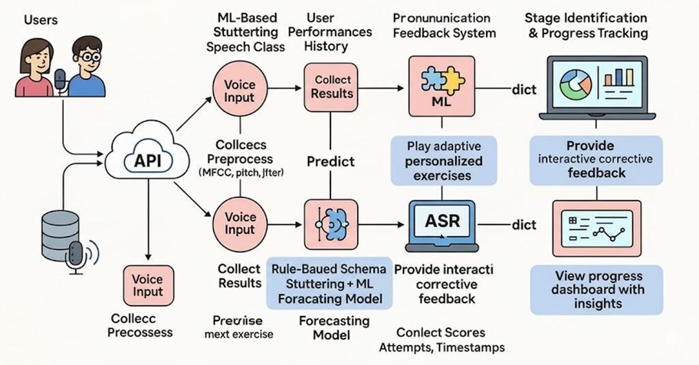
SYSTEM ARCHITECTURE & INTEGRATION

Slide 6
ML-Based Stuttering Speech Classifier
Personalized Exercise Recommender
IT22565044 - K.P.S Chithakshana
IT22590862 - S.M.C.N. Serasinghe
Detects repetitions, prolongations, and blocks.
Adapts exercises using hybrid rule-based + ML (KNN/Decision Tree).
Adjusts session difficulty based on performance history.
Enables independent home practice with clinician-like personalization.
Automatically detects stuttering.
Extracts acoustic features (MFCCs, pitch, jitter) for real-time analysis.
Cloud-based REST API enables remote assessment.
Pronunciation Feedback System
Progress Tracking & Predictive Dashboard
IT22563064 - R.G.S.N.C. Rathninda
IT22273758 - K.A.I. Fernando
Interactive Pronunciation Feedback:
Uses ASR (Whisper/Google STT) for phoneme-level accuracy.
Provides immediate auditory corrective feedback.
Child-friendly mobile interface for self-paced fluency practice.
Progress Tracking & Reporting:
Visualizes fluency trends and severity scores using Streamlit/Plotly dashboards.
Predicts future improvement with time-series forecasting (Prophet).
Generates exportable clinical reports for parents and therapists.

Slide 7

COMPLETION STATUS

Slide 8
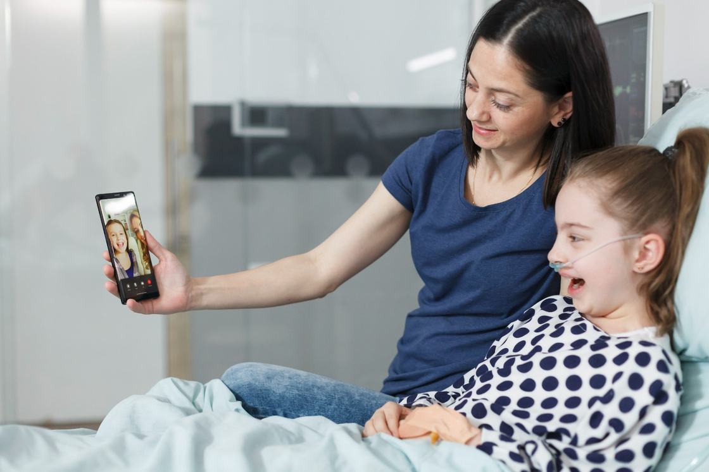
COMMERCIALIZATION & IMPACT
Value Proposition
The first AI-driven tool tailored for the Sinhala linguistic context, offering a cost-effective alternative to intensive clinical sessions.
Market
Children aged 5-10 in Sri Lanka and underserved rural regions globally.
Cost/Feasibility
Low-cost implementation (~$60.80 budget) leveraging cloud free-tiers and existing mobile hardware.
Adoption Plan
Pilot testing at Lady Ridgeway Hospital under SLP supervision followed by integration into school-based screening programs

Slide 9
BORCELLE
THANK YOU

